Slide 1
Analysis of Used Car Values
By Ramadan El-Nil, Shelby Franco and Michael Ortiz
STA 4345
Dr Larry Tang

Slide 2
Data Set
We pulled used car prices from Craigslist listings around the United States.
Questions:
Can we find the variables of a used car which will accurately predict that vehicle’s price?

Slide 3
Data processing for Analysis
Full list of variables: region, price, year, manufacturer, model, conditions, cylinders, fuel, odometer, title_status, transmission, vin, drive, size, type, paint_color, image, description, county, state, latitude, longitude
We removed obviously insignificant variables such as VIN, county, latitude, longitude, and title status, and data with clearly fake odometer readings
Due to the immense size of the data set, we worked only with Florida vehicles, and simplified manufacturer to domestic or import

Slide 4
Priors
The priors we selected to focus on were age of vehicle, mileage, domestic vs import, and condition (salvage, fair, good, excellent, like new, new)
Transformed price and year to log, for Gaussian uncertainty distribution.
We chose the specific priors because we had information that used cars were valued mostly by their engine condition
Region also plays a part, but we didn’t have the computing power to include region.

Slide 5
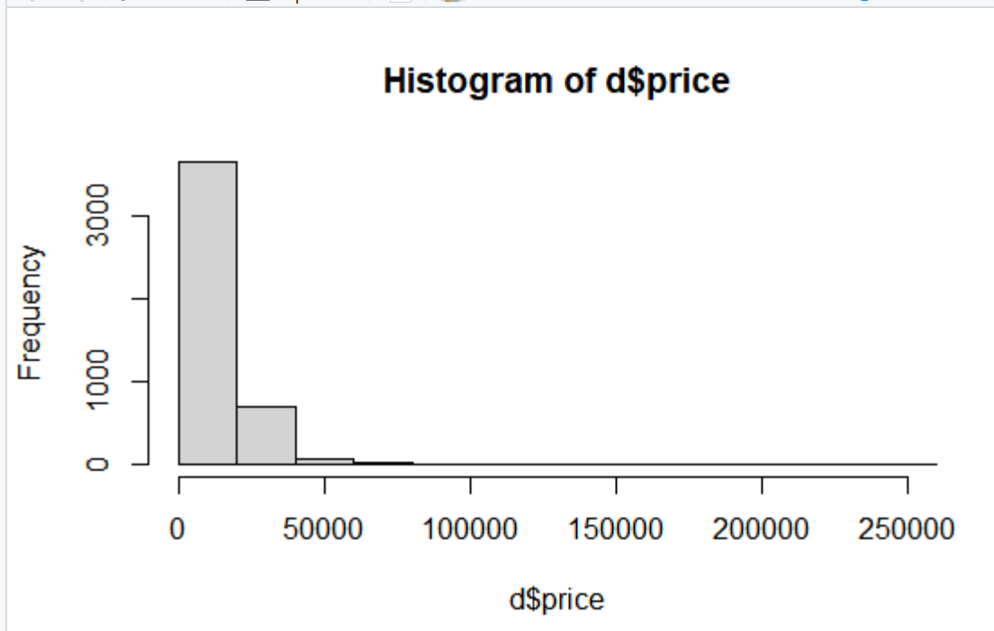
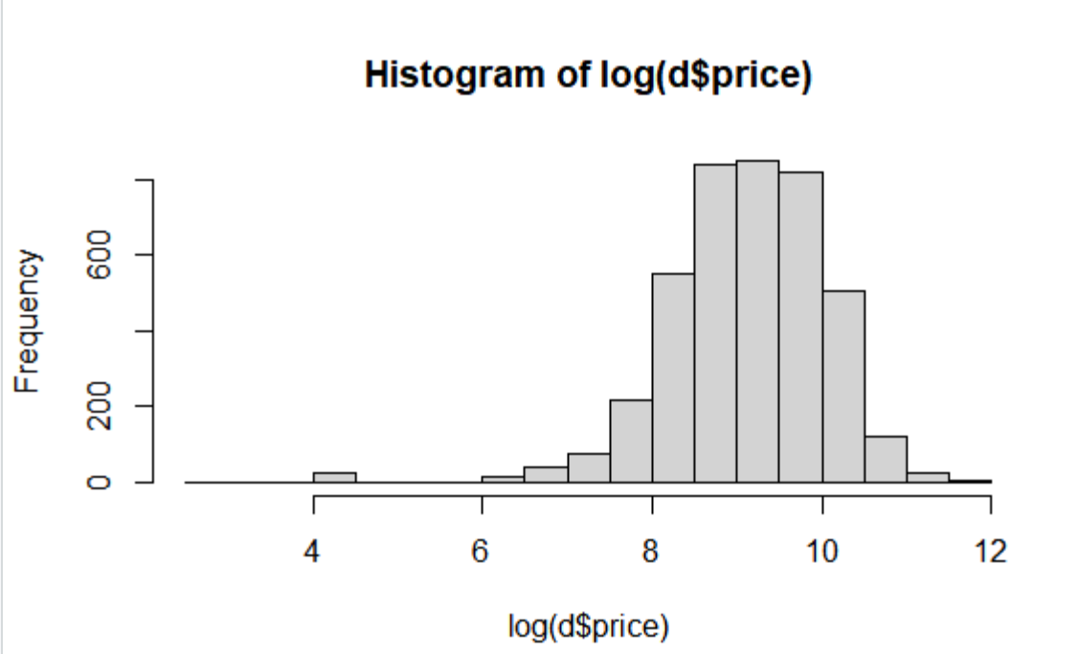

Slide 6
Fitting the Model
Fit a multiple regression model using all of the other variables as predictors for price
The categorical variables are given a dummy for each factor level. R Code:
a ~ dnorm(9, 2),
b1 ~dnorm(7.6,0.05),
b2 ~dnorm(12,2),
b3 ~dbinom(0,1),
b4 ~dnorm(0,1),
b5 ~dnorm(0,1),
b6 ~dnorm(0,1),
b7 ~dnorm(0,1),
b8 ~dnorm(0,1),
b9 ~dnorm(0,1),
sigma ~ dunif(0,10)
), data=d)

Slide 7
Linear Regression Model
mu <- a + b1*log_years + b2*log_miles + b3*Domestic + b4*condition_excellent + b5*condition_fair + b6*condition_good + b7*condition_ln + b8*condition_new + b9*condition_salvage

Slide 8
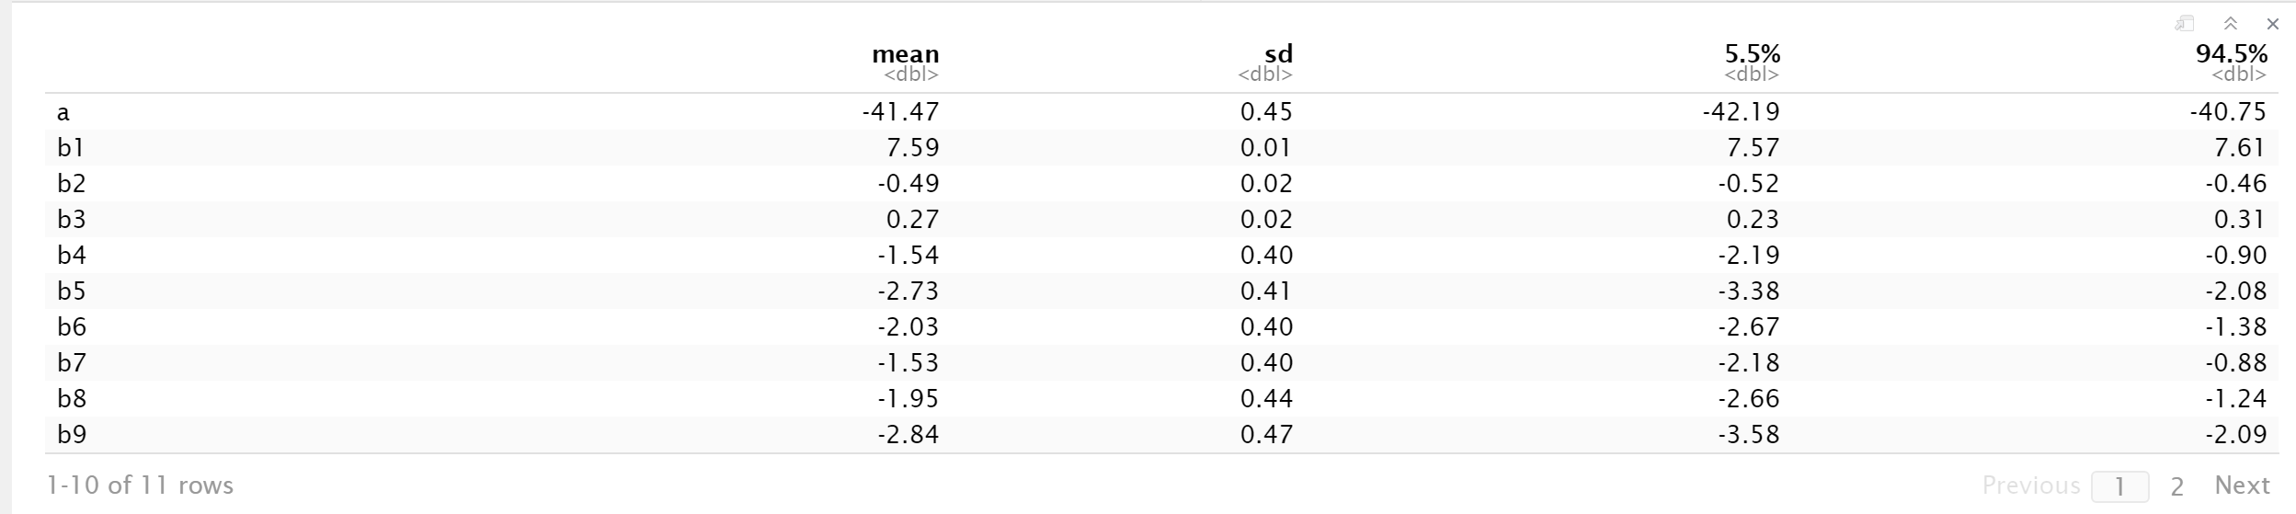
Posterior output
HDPI: precis(m1)

Slide 9
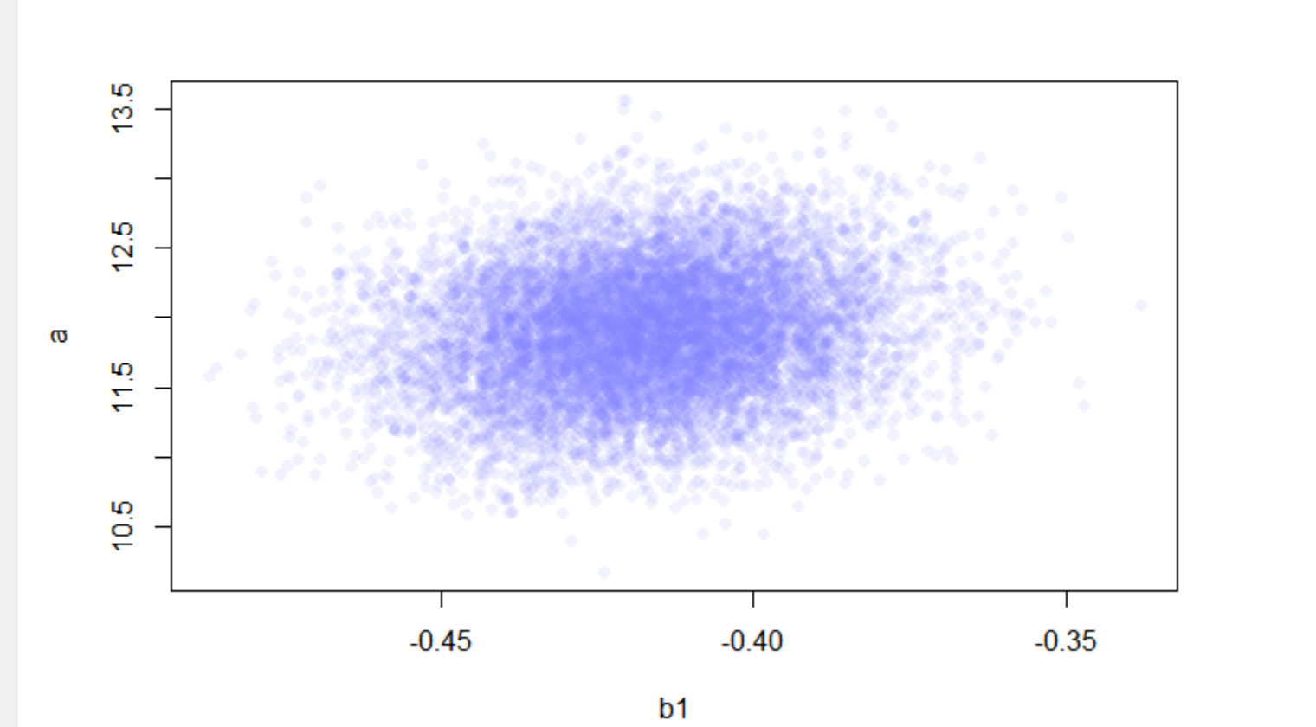
Distribution of y-intercept

Slide 10
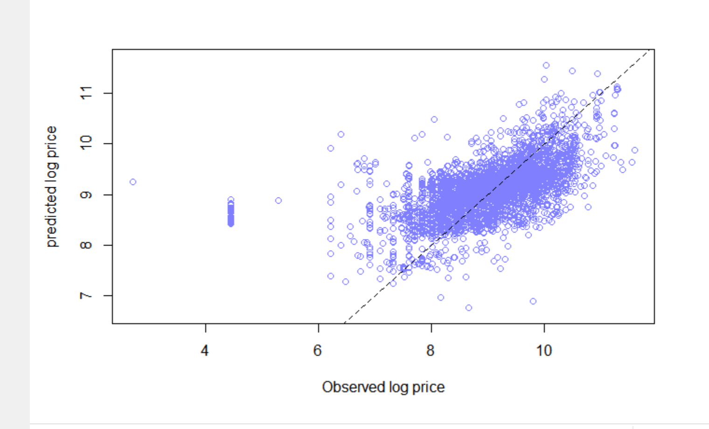
Plotting Predicted vs Observed

Slide 11
Conclusions
Given how noisy the dataset ended up being, we were able to develop a reasonably useful model with the variables we chose.
There is room for improvement, and more questions to be explored, though they might be beyond the scope of this project.

